Slide 1
Three ways to have custom domain name:
Buy a domain name from godaddy.com
Changing the autogenerated subdomain from Shopify Settings
Buy a domain name Within Shopify.com

Slide 2
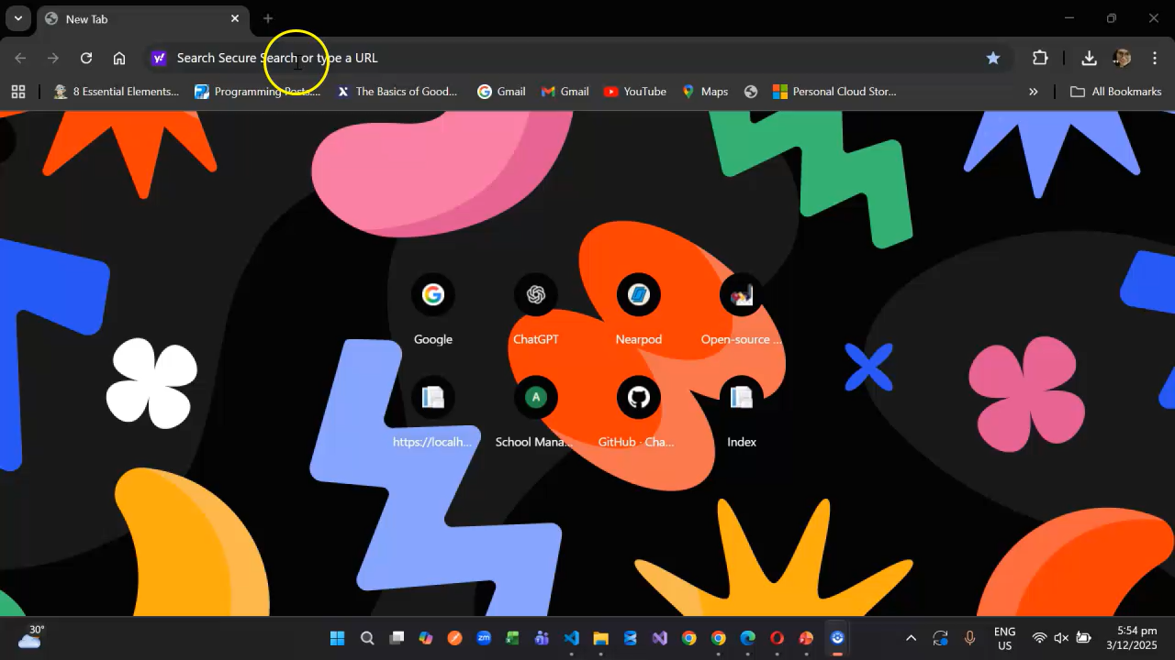
1. Buy a domain name from godaddy.com

Slide 3
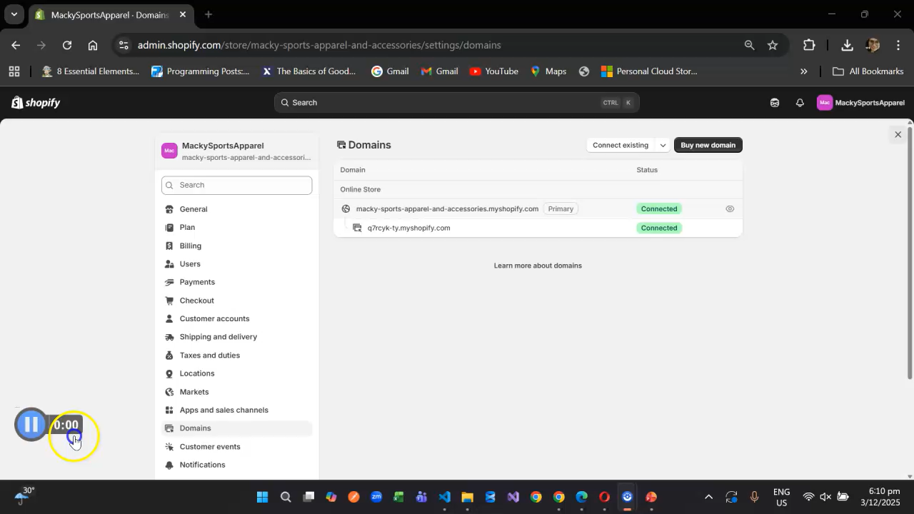
2. Changing the autogenerated subdomain from Shopify Settings

Slide 4
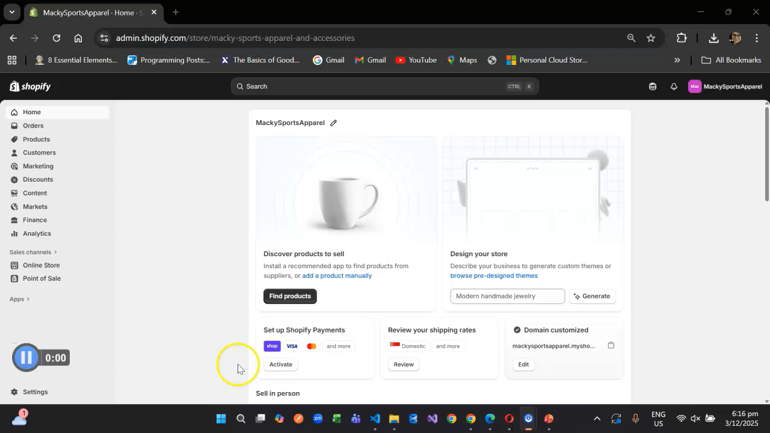
3. Buy a domain name Within Shopify.com

